Slide 1
Haunted Halloween
Escape from the
jack o’lantern
Group 29

Slide 2
outline
01
story
02
instruction
03
code

Slide 3
01
story

Slide 4

On halloween night
A kid had a nightmare on Halloween night. He hided under the covers. When he finally chilled out , he glanced through a small hole on the sheet. Which is surprising him is that a whole world is changed. All he saw is a dark
world with many pumpkins. Those pumpkins have eyes and mouth. And they are chasing to him. All he know to do is run.

Slide 5



character
A kid
Lantern soldier
Lantern elder

Slide 6
Instruction
02

Slide 7
Mode
Level Mode
5 level
Unlimited mode
continue until died

Slide 8
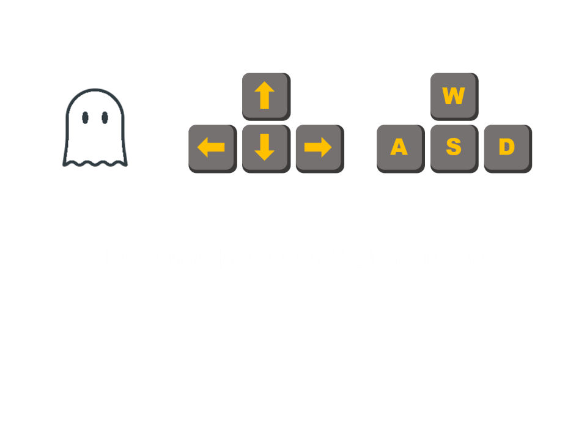
Move and attack
Press to move
Move mouse to aim
Left-click to attack

Slide 9
hp
100
30
80

Slide 10




Property
Attack 3 points hp
Add 50 points hp
Defended from attack
Speed up 1.5x

Slide 11
Points
15 pts
40 pts

Slide 12
03
Code

Slide 13
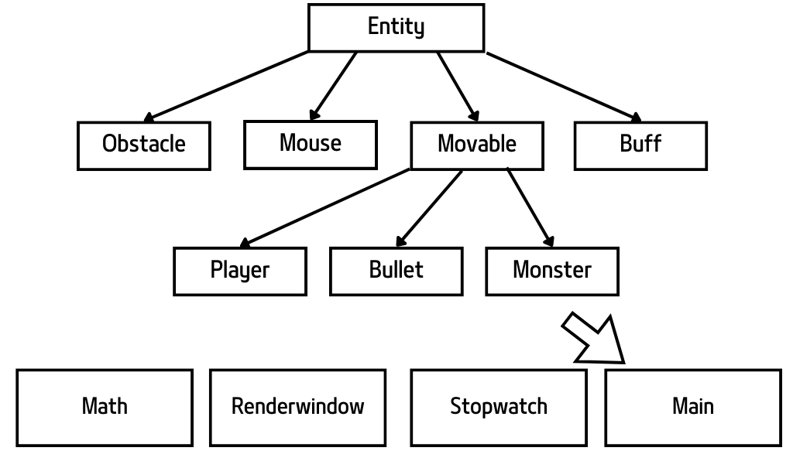
structure

Slide 14
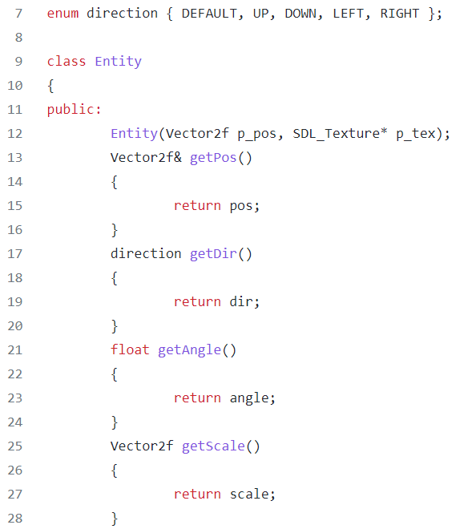
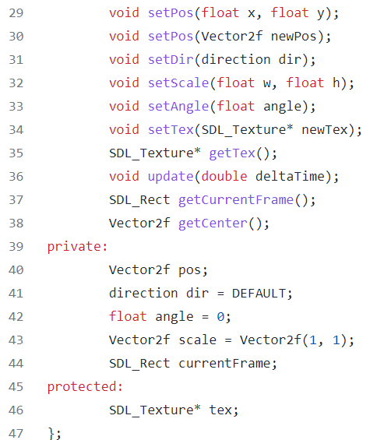
Entity

Slide 15
Thank you !!

